Slide 1


SOFTWARE ENGINEERING (Week-6)
Usama Musharaf
MS-CS (Software Engineering)
Lecturer (Department of Computer Science)
FAST-NUCES Peshawar

Slide 2
Agenda of week # 6
Types of Coupling & Cohesion (Cont..)
Conceptual Model of Architecture Representation
Architectural Views
Views and View Point
4+1 View Model

Slide 3
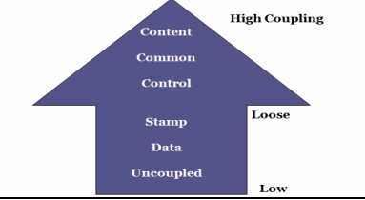
Types of Coupling

Slide 4
Content Coupling
This is highest level of coupling and occurs if there are two (or more) modules and if one refers to the ``inside'' - the ``internal'' or ``private'' part - of the other in some way.
Component A handles lookup data.
Component is handling the property of adding new customer when needed.
Component-A
Component-B

Slide 5
Content Coupling Example
When we are searching the customer data and customer is not found, lookup component adds customer by directly modifying the contents of the data structure containing customer data (new customer).
This is a very high level of coupling in which one component is directly modifying the content of another component and this is not wanted in any software design.
Component-A
Component-B

Slide 6
Content Coupling Example
Solution:
When customer not found, component calls the AddCustomer () method that is responsible for maintaining customer data rather than directly modifying data structure.

Slide 7
Common Coupling
Common coupling occurs when modules communicate using global data structures.
For example, programming allows the developer to declare a data element as external, enabling it to be accessed by all modules.
Common coupling is also known as “Global coupling”. We can say that two components share data using Global data structures.

Slide 8
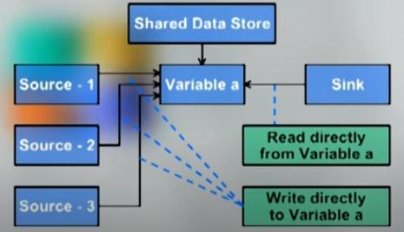
Common Coupling Example

Slide 9
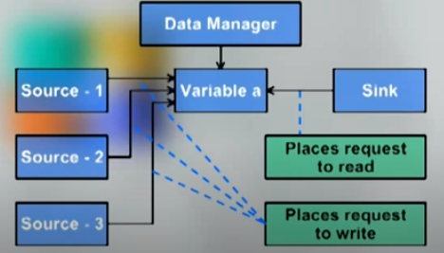
Common Coupling
Solution:

Slide 10
Control Coupling (Moderate Coupling )
Two modules exhibit control coupling if one (``module A'') passes to the other (``module B'') a piece of information that is intended to control the internal logic of the other.
In control coupling, we need to take care off components when it comes to testing.
Our Focus should be on integration testing.

Slide 11
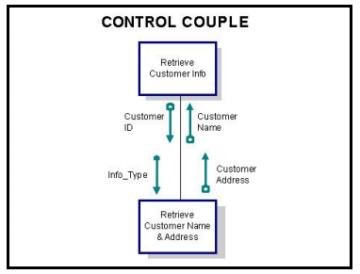
Control Coupling Example
Unsorted List
Sort the List

Slide 12
Stamp Coupling
Beginning of Low level coupling.
Stamp coupling is when modules share a composite data structure and use only a part of it, possibly a different part (e.g., passing a whole record to a function that only needs one field of it)
or
Two modules (``A'' and ``B'') exhibit stamp coupling if one passes directly to the other a ``composite'' piece of data - that is, a piece of data with meaningful internal structure - such as a record (or structure), array, or (pointer to) a list or tree.

Slide 13
Stamp Coupling Example
Example: Customer Billing System
The print routine of the customer billing accepts a customer data structure (cid, customer name, address, phone no, email address, NIC, cell no, passport no) as an argument, parses it, and prints the name, address, and billing amount.
The billing amount is retrieved on the basis of cid which is passed as an argument in the module.
Only cid, customer name and address is used other attributes are not used or in other word they are not needed.

Slide 14
Stamp Coupling Solution
The print routine takes the customer name, address, and billing information as an argument rather than taking the whole structure as input.

Slide 15
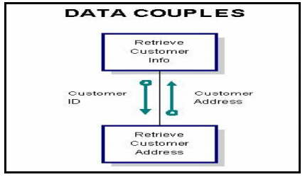
Data Coupling – Low level of Coupling
Data coupling occurs between two modules when data are passed by parameters using a simple argument list and every item in the list is used.
Example:

Slide 16
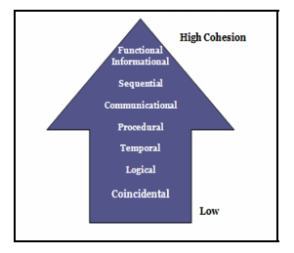
Types of Cohesion

Slide 17
Coincidental Cohesion- Lowest Cohesion
Coincidental cohesion occurs when parts of the component are only related by their location in source code.
A coincidentally cohesive module is one whose activities have no meaningful relationship to one another.

Slide 18
Coincidental Cohesion- Lowest Cohesion
Coincidental cohesion is considered the worst level of cohesion.
Its activities are not related by flow of data or by flow of control.

Slide 19
Coincidental Cohesion- Lowest Cohesion
Example:
Print next line
Reverse string of characters in second argument
Add 7 to 5th argument.
Convert 4th argument to float.
All the above functions have no relationship but they are there in the same module by chance!!

Slide 20
Logical Cohesion
In this level of cohesion elements of component are related logically and not functionally.
Example:
In performing an I/O operation a component reads inputs from tape, disk, and network.
All the code for these functions is in the same component.
It is to note that operations are related, but the functions are significantly different i-e the way to execute each function is different by the different ways of performing I/O belong to same category that’s why they are in same module.

Slide 21
Temporal Cohesion
A temporally cohesive module is one which performs several activities that are related in time.
Temporally cohesive modules typically consist of partial activities whose only relationship to one another is that they are all carried out at a specific time.

Slide 22
Temporal Cohesion
Example:
Consider a module called "On_Really_Bad_Failure" that is invoked when a Really_Bad_Failure happens.
The module performs several tasks that are not functionally similar or logically related, but all tasks need to happen at the moment when the failure occurs.
The module might
Cancel all outstanding requests for services
Notify the operator console of the failure
Make an entry in a database of failure records

Slide 23
Procedural Cohesion
Elements of a component are related only to ensure a particular order of execution.
In this type of cohesion the elements are arranged together in the module but with a condition that there is particular sequence to be followed to execute them.
Activities in a procedurally cohesive module are related by flow of execution rather than by one problem-related function.

Slide 24
Procedural Cohesion
Example:
Suppose there is a module which intents to repair the damaged record of the database and then update the maintenance file.
In this kind of application we can’t repair the damaged record without reading it from the database; we can only repair the record after reading it from the database. So the order the execution may be:
Read data from data base.
Update repair record.
Create an entry in log file of maintenance.

Slide 25
Communicational Cohesion
In communicational cohesion, module performs a series of actions related by a sequence of steps to be followed by the product and all actions are performed on the same data.
A communicational cohesive module is one which performs several functions on the same input or output data.

Slide 26
Communicational Cohesion
Example:
Read record from database
Process data (Gpa calculation)
Generate Report (Print)

Slide 27
Sequential Cohesion
A sequentially cohesive module contains activities where output data from one activity serves as input data to the next activity.
In general, a sequentially cohesive module has good coupling and is easy to maintain.

Slide 28
Sequential Cohesion
Example
Suppose we want to edit the customer data we need to perform the following tasks in sequence:
Retrieve customer Data.
Retrieve customer order.
Generate invoice.
Get and edit input data.

Slide 29
Functional Cohesion- Highest Cohesion
A functionally cohesive module performs one and only one problem related task and every essential element to a single computation is contained in the component.
A functionally cohesive module performs one and only one problem related task.
This is ideal situation.

Slide 30
Functional Cohesion- Highest Cohesion
Functionally cohesive modules are good candidates for re-use and systems built with functionally cohesive modules are easily understood and, therefore, easier to maintain.
Example = ?

Slide 31
Conceptual Model of an Architecture Description
ISO/IEC/IEEE 42010

Slide 32
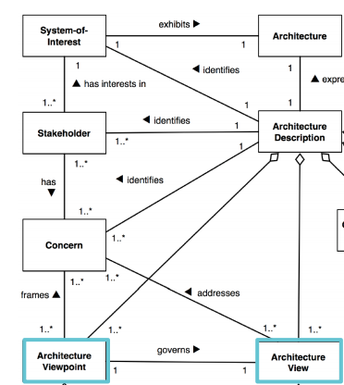

Slide 33
Introduction to Views
Dictionary Meaning
Manner of looking at something
Why (multiple) view ?
For better understanding and managing.
Multi dimensional view must be taken for any complex entity because of its complex nature ,
It can’t be described in 1 dimensional view.

Slide 34
Introduction to Views
For example, In civil what are the views of a building…
Room layout
3D view of building / room
Electrical diagram
Plumbing diagram
Security alarm diagram
AC duct diagram etc…etc…
Which of the above view is Architecture?
In Software, What are views ? ………..

Slide 35
Definition of SW View
As per IEEE definition,
Software architecture descriptions are commonly organized into views,
Each view addresses a set of system concerns, following the conventions of its viewpoint.
Viewpoint - A position or direction from which something is observed or considered;
View – Details or full specification considered from that viewpoint

Slide 36
So, a view of a system is a representation of the system from the perspective of a viewpoint.

Slide 37
Architecture
1
M
Views
1
Viewpoints
M

Slide 38
View Model
Software designers can organize the description of their architecture decisions in different views.

Slide 39
4+1 view model
The 4+1 view is an architecture verification technique for studying and documenting software architecture design.

Slide 40
The 4 +1 View Model
The 4+1 view model was originally introduced by Philippe Kruchten (Kruchten, 1995).
The model provides four essential views:
the logical view,
the process view,
the physical view,
the development view
and fifth is the scenario view

Slide 41
4+1 View Model of Architecture
Logical view
Development view
Scenarios
Process View
Physical View

Slide 42
The 4+1 view model
Multiple-view model that addresses different aspects and concerns of the system.
Standardizes the software design documents and makes the design easy to understand by all stakeholders.

Slide 43
The Scenario View- Use Case View
The scenario view describes the functionality of the system, i.e., how the user employs the system and how the system provides services to the users.
It helps designers to discover architecture elements during the design process and to validate the architecture design afterward.

Slide 44
The Logical or Conceptual View
The logical view is based on application domain entities necessary to implement the functional requirements.
The logical view specifies system decomposition into conceptual entities (such as objects) and connections between them (such as associations).

Slide 45
The logical view
The logical view is typically supported by
UML static diagrams including class/object diagrams and
UML dynamic diagrams, sequence diagram, state diagram.

Slide 46
The Development or Module View
The development view derives from the logical view and describes the static organization of the system modules.
UML diagrams such as package diagrams and component diagrams are often used to support this view.

Slide 47
The Process View
The process view focuses on the dynamic aspects of the system, i.e., its execution time behavior.
This view maps functions, activities, and interactions onto runtime implementation.
The UML activity diagram support this view.

Slide 48
The Physical View
The physical view describes installation, configuration, and deployment of the software application.
It concerns itself with how to deliver the deploy-able system.
The physical view shows the mapping of software onto hardware.
The UML deployment diagrams are often used to support this view.

Slide 49
HAVE A GOO DAY!

